Slide 1
Hardware accelerator for Efficient error-correcting codes
Christine Kuhlman
Northern Arizona University
Mentor: Dr. Elizabeth Brauer

Slide 2
Intro
Why is this important?
  Static noise is an annoyance
  Error-Correcting Codes can correct for noise
    ECC
  Evaluation of ECCs requires millions of cases
  Software testing is too slow
    C++ and MATLAB
  Hardware accelerator
Transmitter
Noise
Receiver

Slide 3
Objectives
Gather Statistics
Display Statistics
Optimize Field Programmable Gate Array Speed
  FPGA
Implement Realistic Code

Slide 4
Hardware Accelerator
Gaussian Noise Generator
  GNG
Low-Density Parity-Check
  LDPC
Transmitter
“0000”
GNG
Receiver
“0010”
LDPC

Slide 5
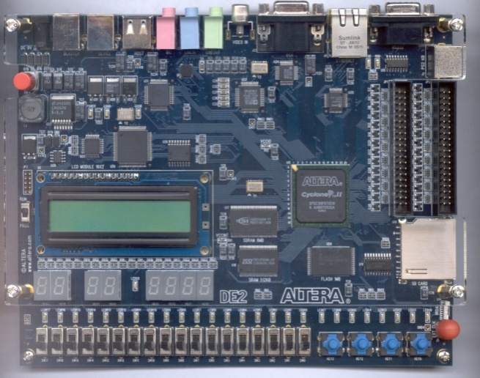
Data
Taken using Cyclone II
  Programmed in VHSIC Hardware Design Language
    VHDL
  FPGA implemented

Slide 6
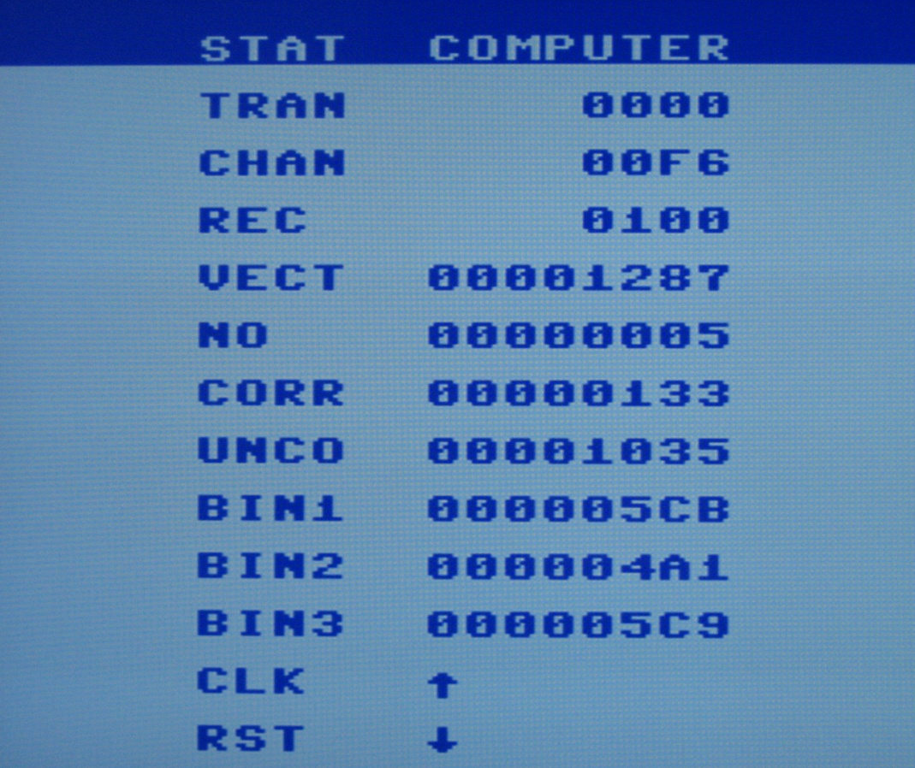
Analysis
FPGA vs. VHDL
FPGA vs. C++ or MATLAB

Slide 7
Conclusion
Most important part
  Functional hardware accelerator with a realistic code
Future work
  Even more complex codes
  Add LDPC
  Tool to evaluate ECC

Slide 8
Acknowledgements
NASA Space Grant
Dr. Elizabeth Brauer – Mentor
Dr. Sheryl Howard
Mike Thomson

Slide 9
References
[1] D Lee, W Luk, J D. Villasenor, and P.Y.K. Cheung, “A Gaussian Noise Generator for Hardware-Based Simulations,” IEEE Transactions on Computers, vol. 53, no. 12, pp. 1523-1534, Dec. 2004.
[2] DE2 Development and Education Board. <http://www.altera.com/education/univ/materials/boards/uni-de2-board.html>, 22 Feb. 2009

Slide 10
Any Questions?

